Slide 1
hour 4
Static Mesh Editor:
Working with Static Mesh Assets and Actors

Slide 2
introduction
In this lecture, you will become familiar with importing 3D models, using the Static Mesh Editor, editing collision hulls, and working with Static Mesh assets and Actors.

Slide 3

Lecture Goals and Outcomes
Goals
Outcomes
The goals of this lecture are to
Become familiar with the Static Mesh Editor
Learn how to import 3D model files
Learn to assign Materials and collision hulls to Static Mesh assets
Learn how to place Static Mesh Actors in a Level
Learn how to change mesh and Material references on Static Mesh Actors
Learn to set collision responses on Static Mesh Actors
By the end of this lecture you will be able to
Work with the Static Mesh Editor
Import 3D model files
Assign Materials and collision hulls to Static Mesh assets
Place Static Mesh Actors in a Level
Change mesh and Material references on Static Mesh Actors
Set collision responses on Static Mesh Actors

Slide 4
Static Mesh
Static Meshes are some of the most common art assets and Actor types you will work with in UE4.
Static Meshes are 3D models imported from applications such as 3ds Max or Maya. They are primarily used for set dressing and world building.
Just about every Level you make will use Static Meshes.

Slide 5
Asset
A Static Mesh asset is imported and stored in the Content Browser.
Actor
An asset stores the initial Material assignment for the mesh.
An asset stores initial collision settings.
There can be many instances of a single asset.
Each Actor instance’s properties can be modified individually.
A Static Mesh Actor is a placed instance of a Static Mesh asset in a Level.
An asset stores LOD assignments.
Static Mesh

Slide 6
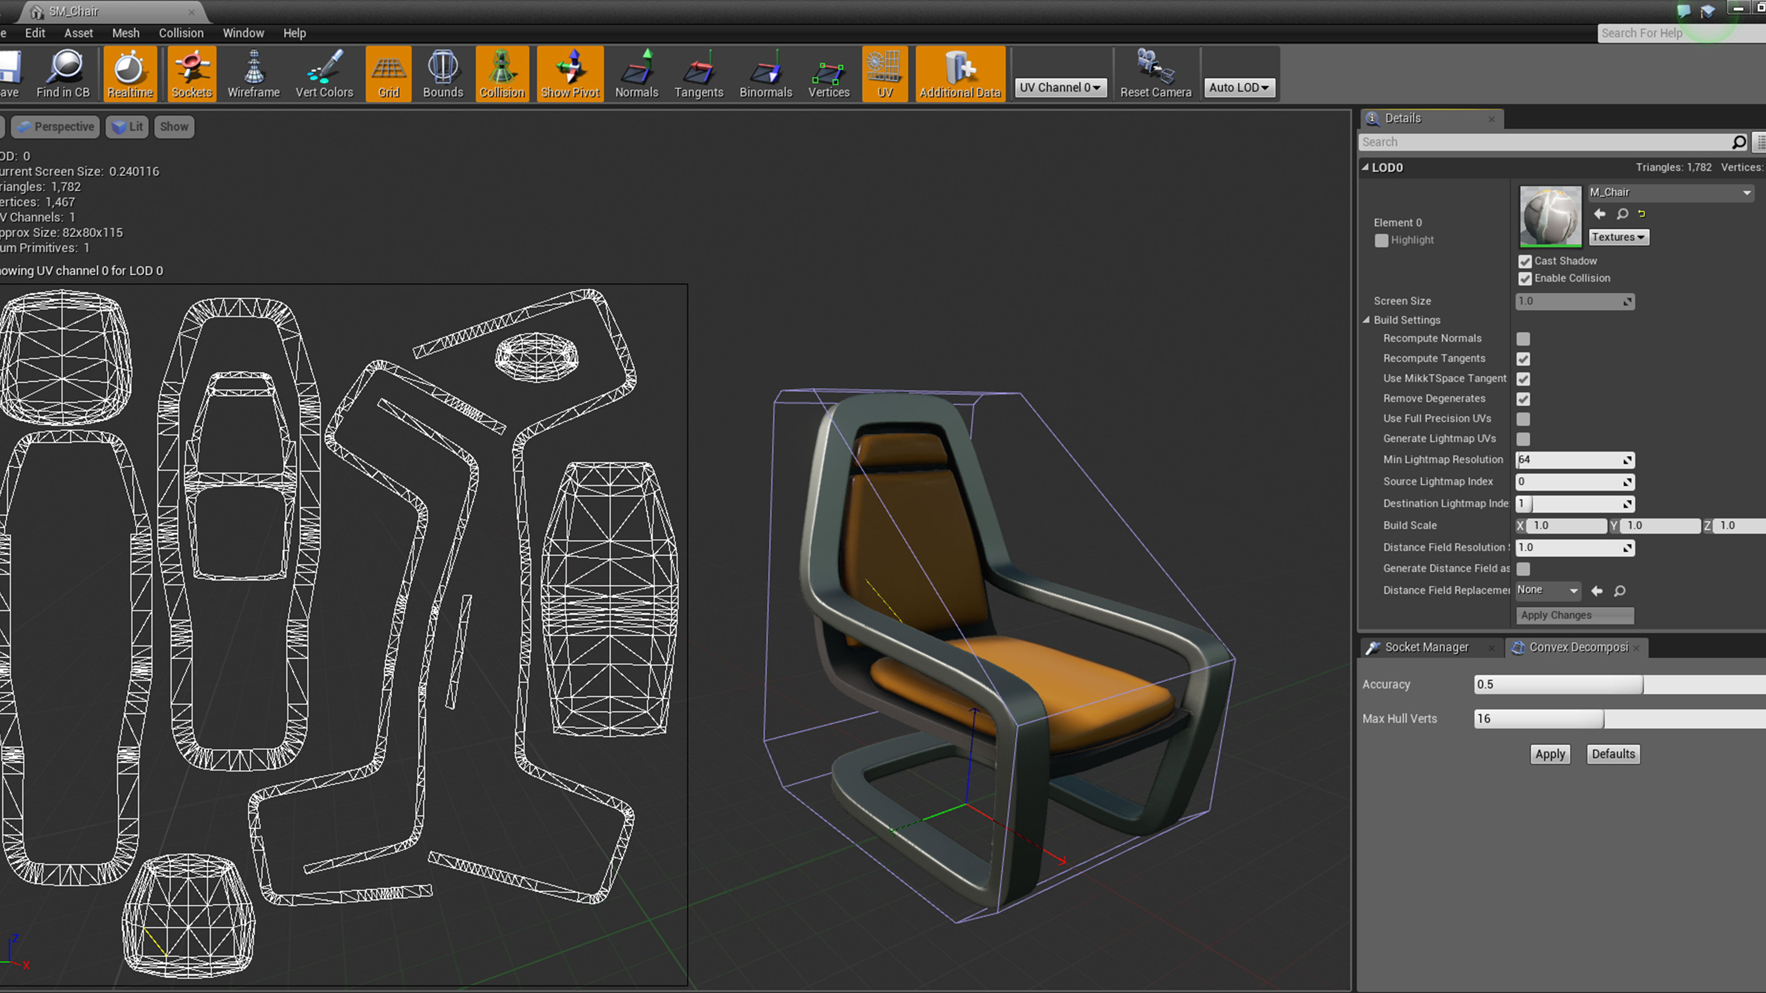
Static Mesh
Static Meshes contain the following:
The pivot point (local axis)
Vertices, edges, and polygons that define the visual look of a model
Levels of detail (LODs)
Collision hulls
Sockets
UV layouts used for projecting Textures and lightmaps
Vertex color assignment

Slide 7
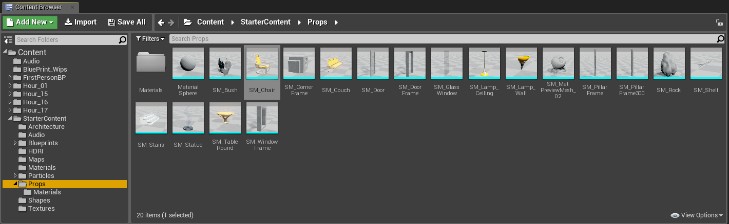
Importing Static Meshes
Two file types are commonly used for importing 3D models into the Editor:
.obj
.fbx

Slide 8
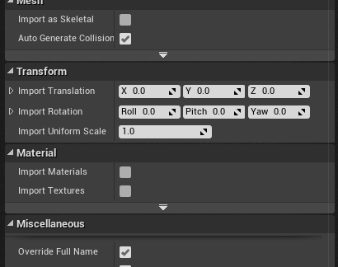
Importing Static Meshes
When you import either file type, you open up an FBX Import Options window.
Auto-generating collision hulls and lightmap UVs on import can speed things up, but you can also edit and modify collision hulls and lightmap UVs in the Static Mesh Editor.

Slide 9
Opening the Static Mesh Editor
To view a Static Mesh in the Static Mesh Editor, double-click the Static Mesh asset in the Content Browser. The Static Mesh Editor will open in a new window.
Each Static Mesh asset you double-click opens its own Static Mesh Editor window.

Slide 10
The Static Mesh Editor allows you to edit, modify, and set base properties for Static Mesh assets stored in the Content Browser.

Slide 11
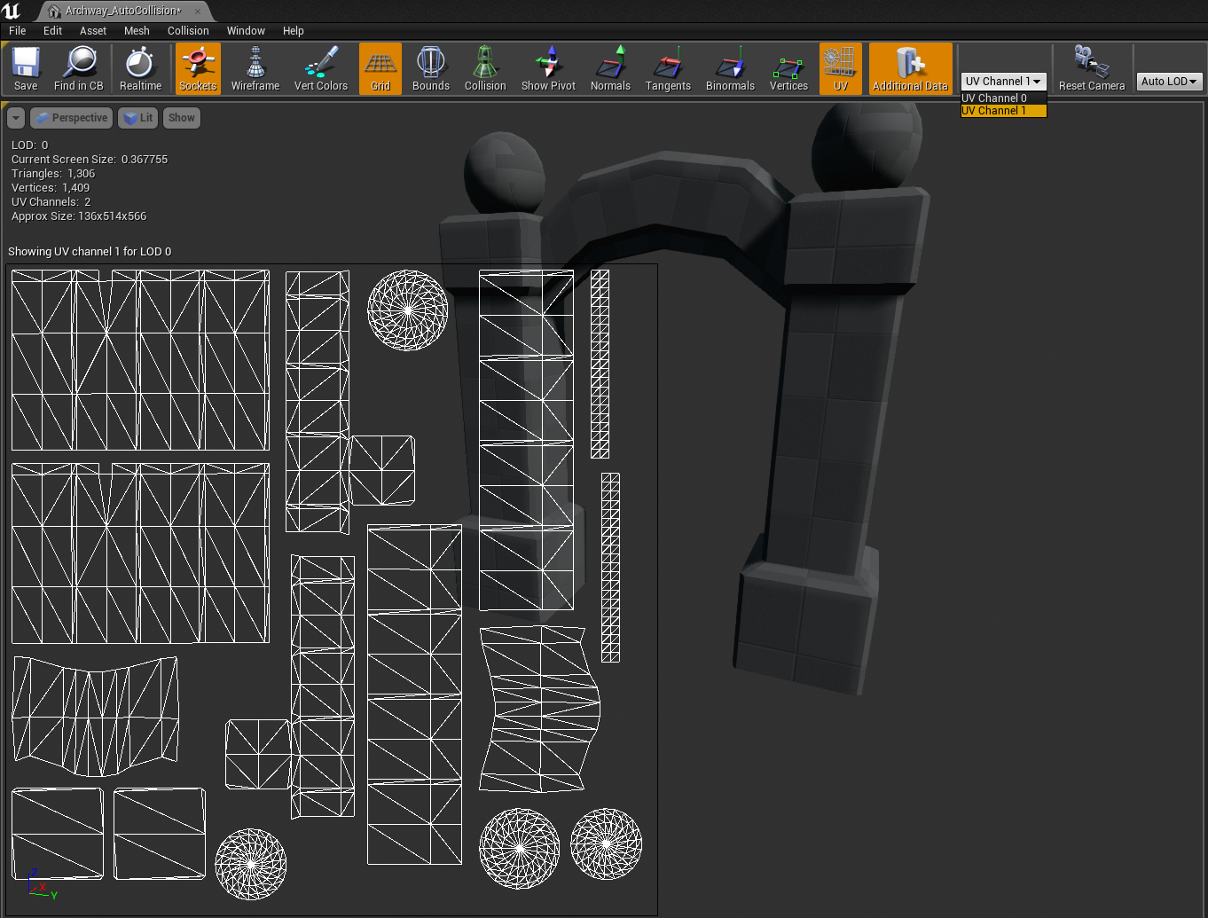
Viewing UV Layouts
Before a Material can be properly displayed on the surface of a model, it needs a UV map layout, also known as a UV channel.
If a model has been created properly in a 3D modeling application, it should already have at least one UV channel set up.
Static Meshes can have multiple UV channels.
Typically there is at least one UV channel for a Material (UV Channel 0) and one for the lightmap data (UV Channel 1).

Slide 12
Viewing UV Layouts
To view the UV channels for a Static Mesh, click the UV button on the toolbar to toggle it on and off.
The current UV channel is displayed in the Viewport window.
You can change which UV channel is displayed by selecting a channel from the drop-down on the toolbar.

Slide 13
The lightmap UV channel is used for storing light and shadow information on the surface of a mesh.
The Editor auto-generates a UV channel for lightmaps during import, but you can also create one after import by using the Static Mesh Editor’s Details panel options.
The default lightmap UV channel is 1, which is the second UV channel because the UV channel index starts at 0.
Although you can technically use any UV channel you want for lightmaps, when starting out it is best to use the default settings.
Lightmap UV Channel

Slide 14
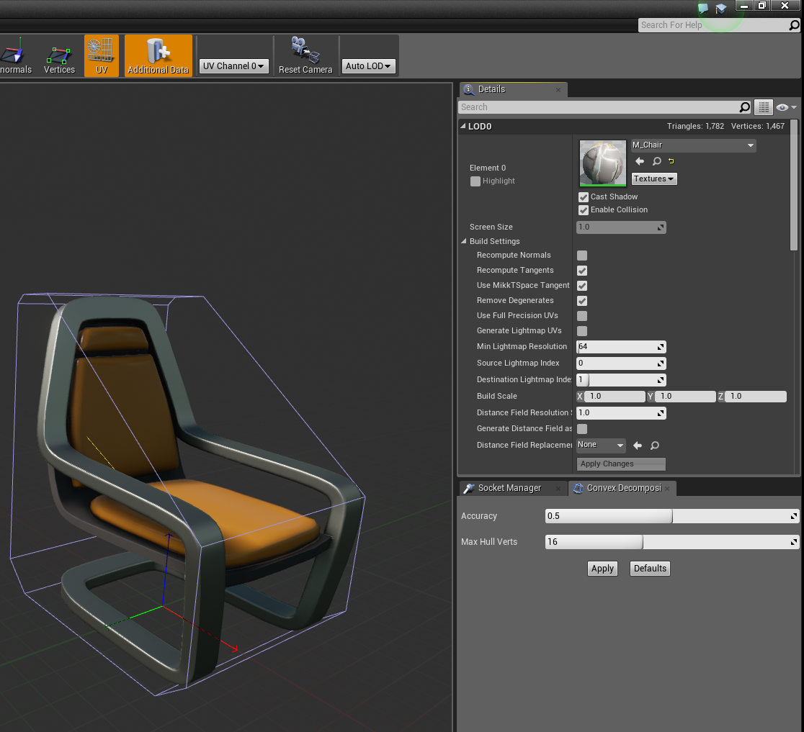
Assigning a Material to a Static Mesh Asset
Because a Static Mesh asset is a base asset, it is a good idea to prep the asset for continual use.
Assign a default Material so that every time the asset is placed in a Level as a Static Mesh Actor, it already has a Material.
Every time you place an instance of the mesh in the Level, you can assign a new Material to that instance if you need to.

Slide 15
Collision Hulls
A collision hull is a simple primitive shape that surrounds a mesh and is used to identify collision events.
A collision event occurs when two Actor collision hulls hit, touch, or overlap with each other.
When you import a 3D model, the Editor auto-generates a simple collision hull.

Slide 16
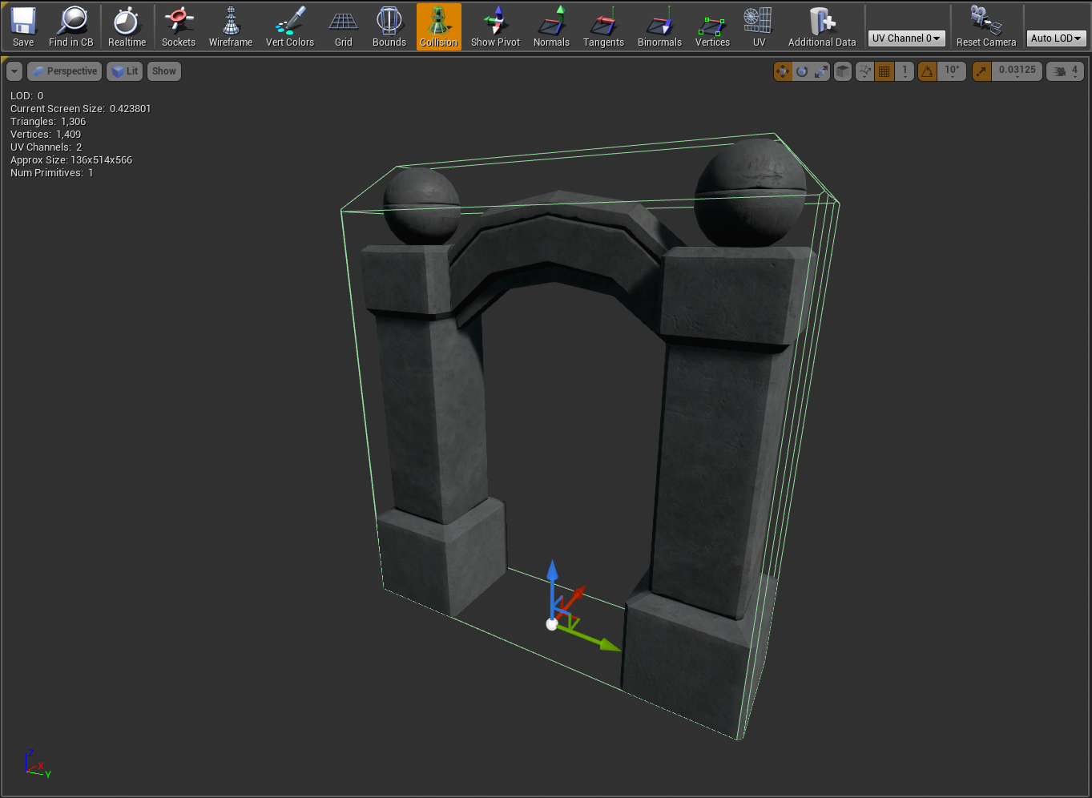
Viewing Collision Hulls
You can view a collision hull in the Static Mesh Editor by clicking the Collision icon on the Static Mesh Editor toolbar.

Slide 17
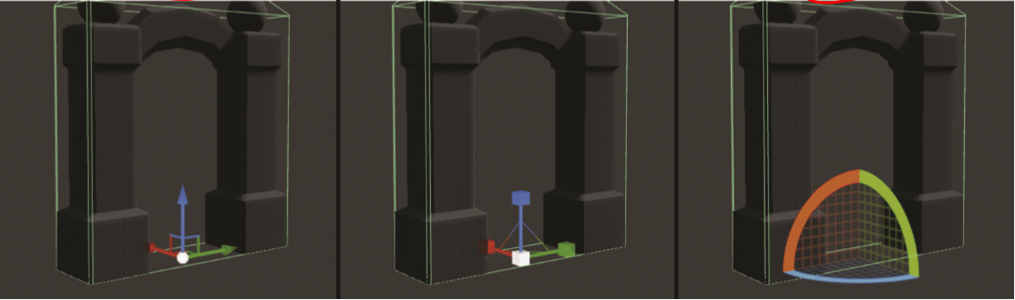
Editing Collision Hulls
You can interact with the collision hull by clicking any of its wireframe edges.
You can move, scale, and rotate the hull by pressing the spacebar to cycle through transform gizmos.
You can remove a selected collision hull by pressing the Delete key.

Slide 18
Editing Collision Hulls
Auto-generating collision hulls during import can save you time, but depending on the shape of the mesh asset, auto-generation may not always be the best solution.
In the image on the right, you can see the auto-generated collision that surrounds the entire Archway mesh. This collision hull will block Actors from passing through the mesh, but it will also stop Actors from walking under the Archway. In this case, the collision hull needs to be modified.

Slide 19
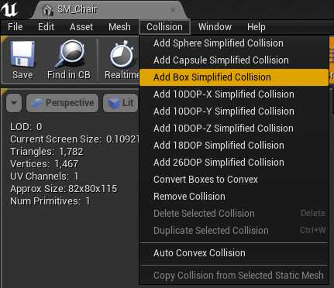
Editing Collision Hulls: Simplified Collision
You can add multiple collision hulls to one Static Mesh.
To add a collision hull, click Collision on the menu bar and select Add collision you want to add. Do this as many times as you like.
If you need to remove a single collision hull, just select it in the Viewport and press Delete.
If you want to remove all of the collision hulls from the Viewport, select Collision > Remove Collision.

Slide 20
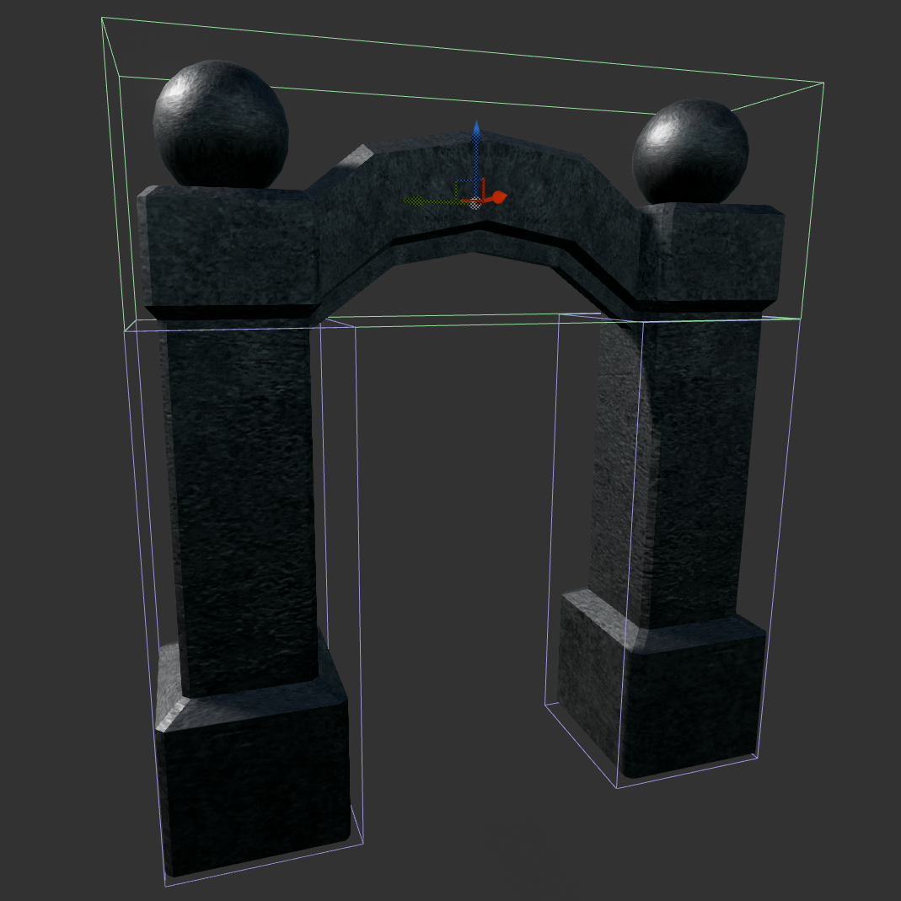
Editing Collision Hulls: Simplified Collision
The image on the right shows multiple Box Simplified collision hulls assigned to a single mesh.

Slide 21
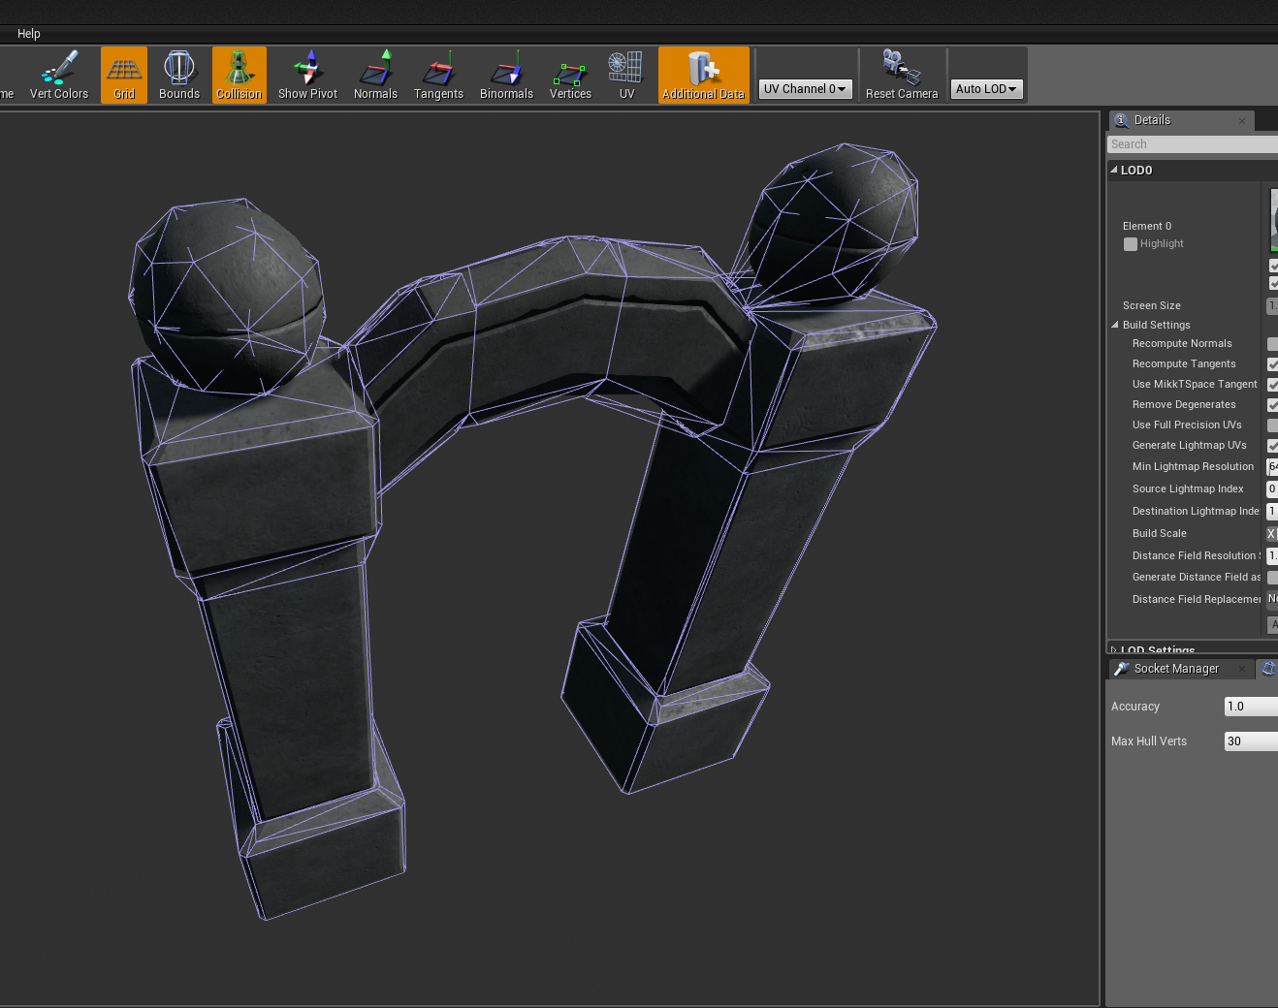
Convex Decomposition
The Static Mesh Editor also has a panel called Convex Decomposition that allows you to auto-generate collision hulls for more complicated models.
Altering the complexity of a Static Mesh and the convex decomposition settings will give you varying results.
To open the Convex Decomposition panel, select Collision > Auto Convex Collision.

Slide 22
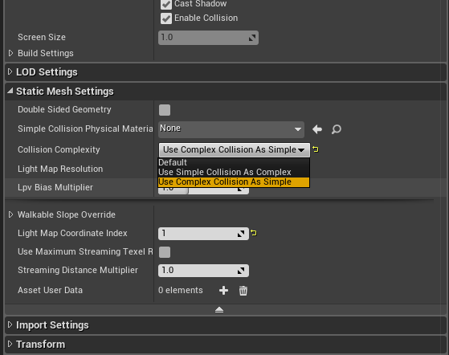
Per-Poly Collision
You can also set Static Mesh assets to per-poly collision, which is the most accurate collision you can have. It is also the most computationally intensive, so you should use it only for specific situations when you need precision.
To set Static Mesh assets to per-poly collision, go to the Static Mesh Settings section of the Details panel and set Collision Complexity to Use Complex Collision as Simple.
This will tell the Editor to use Complex Collision (per-poly) instead of Simple Primitive Convex Primitive.

Slide 23
Working with Static Mesh Actors

Slide 24
Static Mesh Actors
Static Mesh Actors are placed instances of a Static Mesh asset in a Level.
Each placed Static Mesh Actor has its own properties that can be modified independently of the referenced Static Mesh asset.

Slide 25
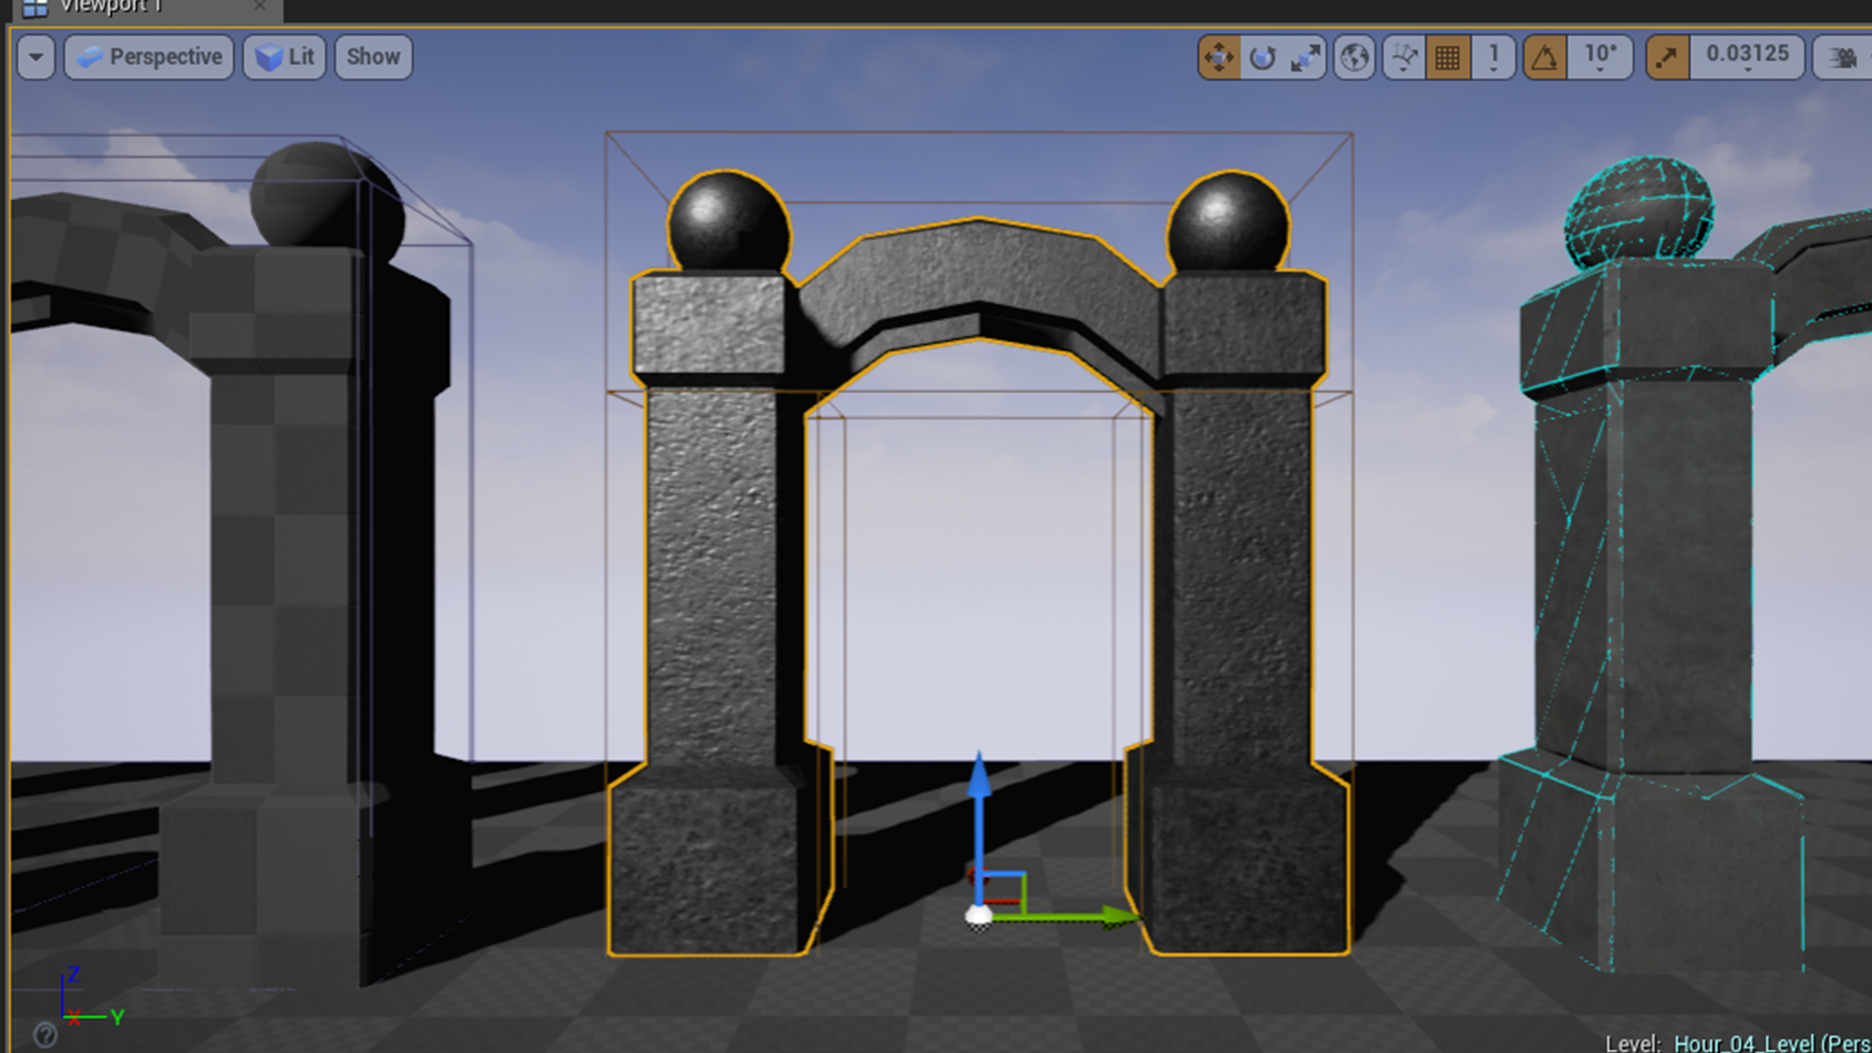
Editing Static Meshes
Changing a Static Mesh asset’s properties can affect all of the Static Mesh Actors that reference it.
For example, if you remove the collision hulls completely from a mesh asset, all the Actors that use that Static Mesh will not be able to generate collision responses.
However, changing a Static Mesh Actor’s properties and settings has no effect on the original Static Mesh asset.

Slide 26
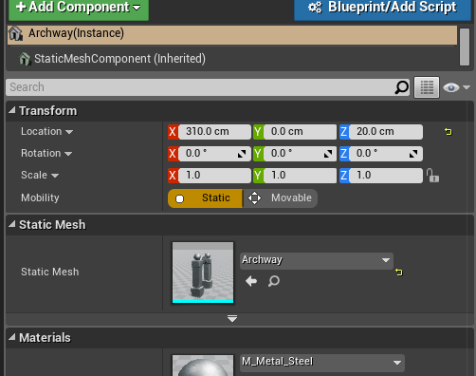
Placing Static Meshes
To place a Static Mesh into a Level, locate one in the Content Browser and simply drag and drop the asset from the Content Browser to the current Level in the Level Editor Viewport.
Once you drag a Static Mesh into a Level, you create a Static Mesh Actor that references the original mesh asset.
If you select a placed Static Mesh Actor in a Level, you see the transform gizmo appear at the Actor’s pivot point.
You can see in the Level Editor Details panel that the Actor has transform properties that store its position, rotation, and scale in the world along with Mobility settings.
While a Static Mesh Actor references the original Static Mesh asset, once it is placed you can change the Static Mesh and the Material reference.

Slide 27
Mobility settings
A Static Mesh Actor has two possible mobility states: Static and Movable.
Changing the mobility state of an Actor ultimately affects how the engine calculates light and shadow information for the Actor.
Static tells the engine that lighting needs to be precalculated.
Movable tells the engine to calculate lighting during runtime.
If you want to animate a Static Mesh Actor or have it simulate physics, you need to set Mobility to Movable.

Slide 28
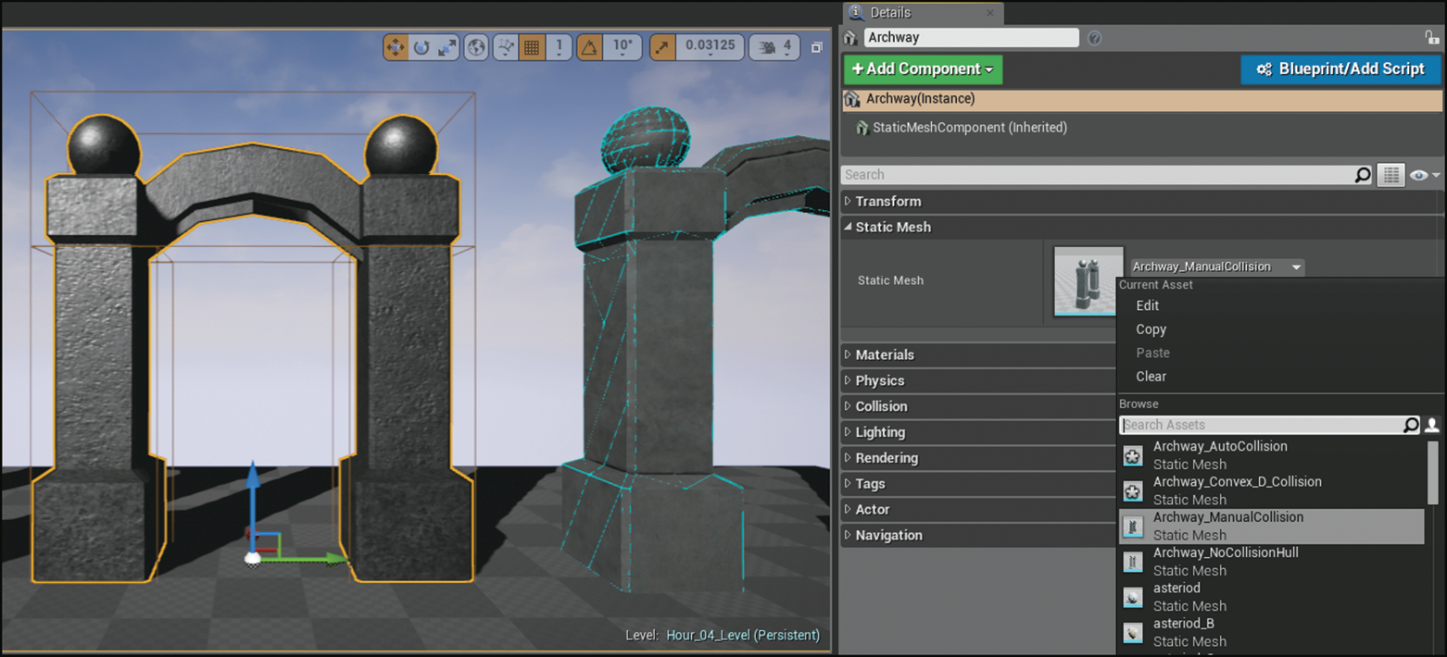
Changing the Mesh Reference for a Static Mesh Actor
A Static Mesh Actor references the initial Static Mesh asset used when the Actor was placed in the Level.
The mesh reference can easily be changed in a couple of ways:
Drag a new mesh asset from the Content Browser to the Static Mesh reference thumbnail in the Level Details panel of the selected Static Mesh Actor.
Click on the drop-down arrow next to the currently assigned mesh and select a new mesh.

Slide 29
Changing the Material assignment on a Static Mesh Actor
A Static Mesh Actor also has a Material reference that is initially assigned based on the original Material assigned to the mesh asset in the Static Mesh Editor.
You can modify the Material for each Actor in a few ways:
Drag a new Material from the Content Browser to the thumbnail image of the current Material in the Details panel.
Click on the drop-down arrow next to the currently assigned Material and select from the list.
Click and drag the new Material from the Content Browser to any of the Static Mesh Actors in the Level.

Slide 30
Editing Collision Responses on a Static Mesh Actor
With a Static Mesh Actor selected in a Level, you can find the collision settings for the Actor in the Level Editor Details panel.
To view Actor collision hulls in the Level Editor Viewport, press Alt+C to toggle collision hull visibility.

Slide 31
Editing Collision Responses on a Static Mesh Actor
Clicking the triangle to the left of Collision Presets in the main Editor Details panel, you can expand the window to show more options.
With a preset already assigned, you see that the collision response options are grayed out and can’t be modified.
The presets define common settings for collision responses for Actors with different object types.
To unlock the options, choose Custom Preset.

Slide 32
Collision Enabled
The Collision Enabled property on the Details panel lets you turn collisions on and off for the selected Actor.
When this is selected, even if the referenced Static Mesh asset for the Actor has a collision hull, the Actor will not process collision interactions and events.

Slide 33
Object Type
The Object Type property on the Details panel allows you to set what kind of object type this Actor is, so when other Actors collide with it, they will know how to respond.
For example, if a Static Mesh Actor is set to Static under Transform, then its object type should be set to WorldStatic, but if it is set to Movable under Transform, the object type should be set to WorldDynamic.

Slide 34
Object Type
Every Actor that can collide has an assigned object type.
There are seven object types:
WorldStatic
WorldDynamic
Pawn
PhysicsBody
Vehicle
Destructible
Projectile

Slide 35
Collision Responses
The Collision Responses section of the Details panel allows you to set how the selected Static Mesh Actor will respond to other Actors with defined object types.
There are three interaction states for collision interactions:
Ignore: Ignore any collision responses of these object types.
Overlap: Check to see if the mesh’s collision hull is intersecting with another Actor.
Block: Stop another Actor from passing through the mesh’s collision hull.

Slide 36
Custom
Collision Presets
You can create your own collision presets for a project by selecting Edit > Project Settings > Collision in the Level Editor main menu.
When you’re first starting out, however, it is easiest to just choose the custom preset and modify the collision response for each Actor directly on the selected Static Mesh Actor.

